Slide 1
SFRTPH-01-01/02
Flush Valve Replacement Instructions

Slide 2
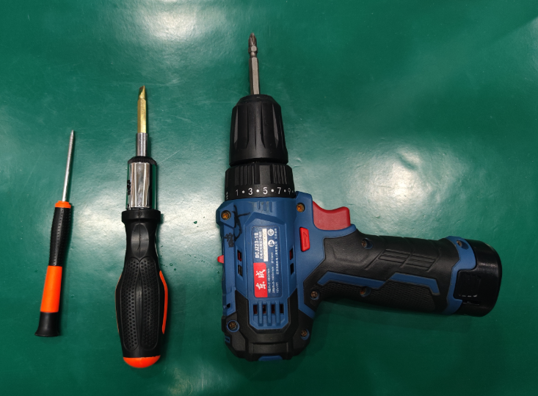
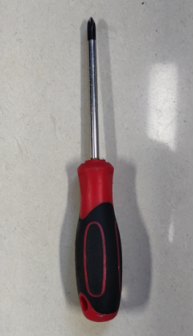
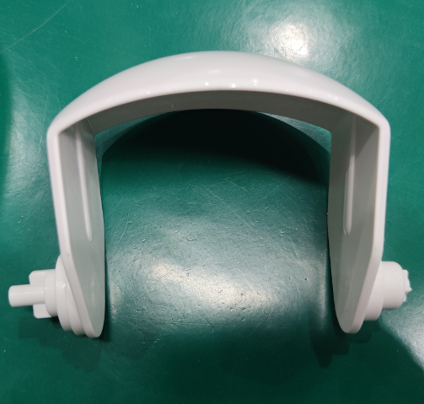
1：Tools, accessories
Tools: 2 Flathead screwdriver
1 Hand drill
1 Cross screwdriver
Accessories: Flush Valve

Slide 3
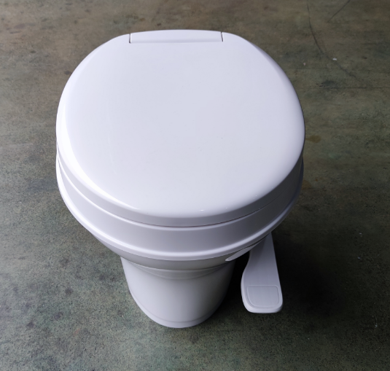
2：Product 产品
Product

Slide 4
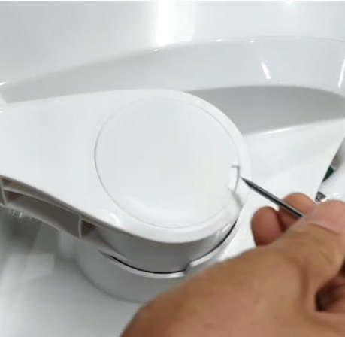
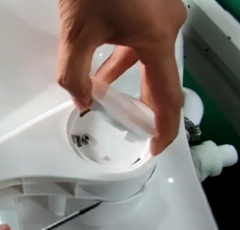
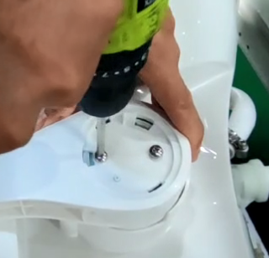
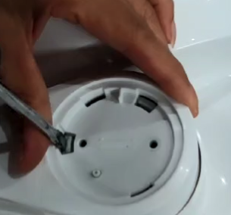
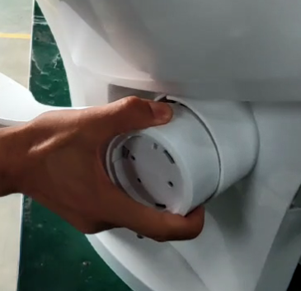
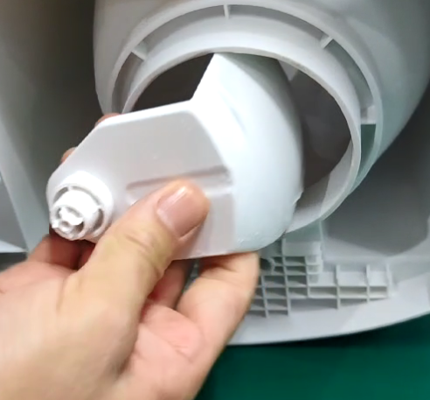
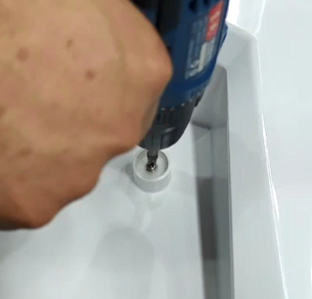
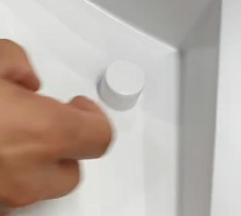
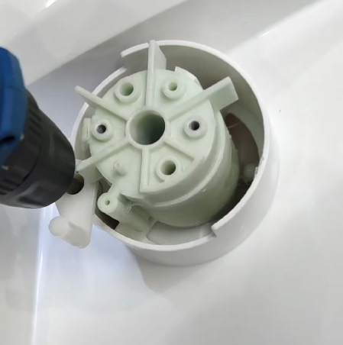
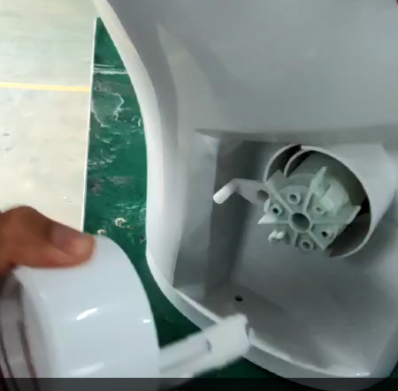
3：Disassemble the Flush Valve
Step 1: Place the toilet on the table, use a small flat-blade screwdriver to insert it into the gap of the side cover, and lift up the side cover.
Step 2: After the side cover is lifted up, remove the side cover
Step 3: Use a cross-head screwdriver to loosen the two pedal kit fixing screws and remove the fixing screws.
Step 4: Use a flat-blade screwdriver to insert the fixing buckle and tilt it inward until the buckle is detached (there are two places).
Step 5: Grasp the pedal with hands and shake it outward to loosen it.
Step 10: Reach into the drain port and remove the flush valve.
Step 9: Use a cross screwdriver to remove the screws in the decorative cover.
Step 8: Remove the decorative cover by hand
Step 7: Use an electric screwdriver to loosen the cam shaft screws and remove the connecting shaft.
Step 6: After the pedal is loosened, remove the pedal kit.

Slide 5
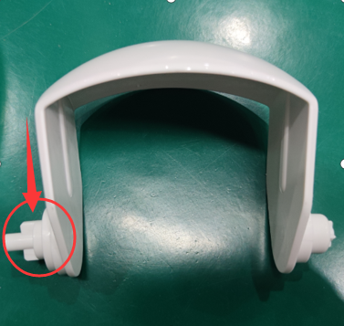
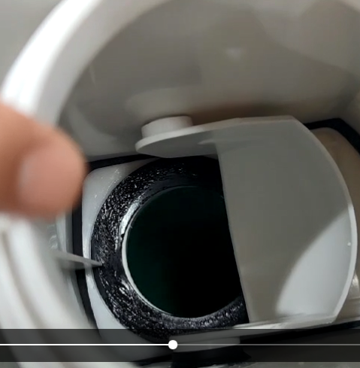
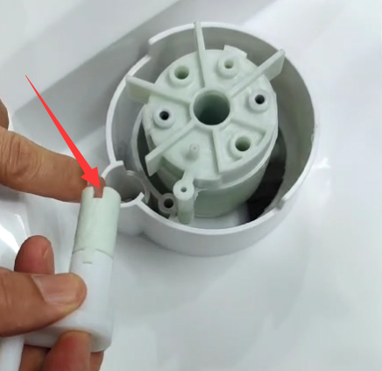
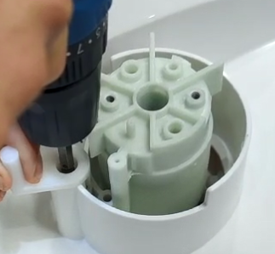
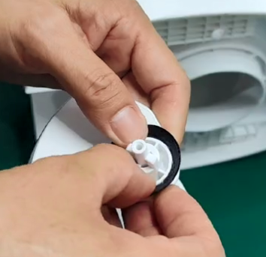
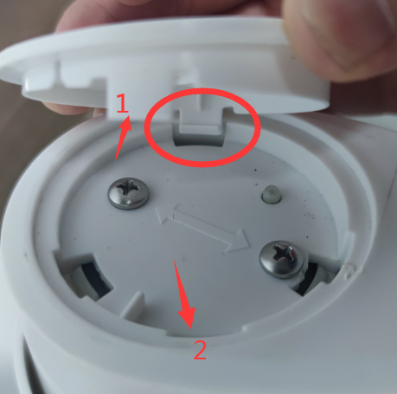
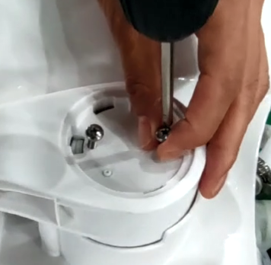
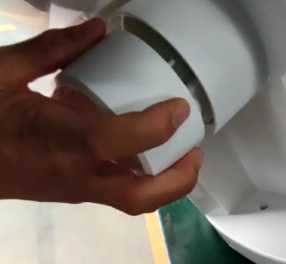
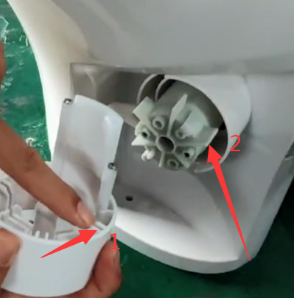
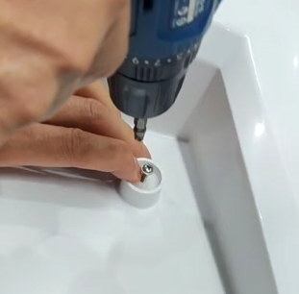
3：Install Flush Valve
Step 2: Insert the flush valve from the drain port, and install the side with the wear-resistant gasket toward the pedal.
Step 3: Align the groove of the cam shaft with the limit position of the groove of the connecting sleeve, and then install the cam shaft.
Step 4: Use a cross drill to fix the screws, and then tighten them with a cross screwdriver (to prevent the screws from slipping)
Step 1: Remove the wear-resistant gasket of the old flush valve and install it on the new flush valve. ( Refer to the right picture for the installation position.)
Step 9: Find the holes of the side cover and pedal, press them in evenly (as indicated by the circle and arrow), and the flush valve is installed.
Step 8: Use a cross-head electric drill to tighten the pedal fixing screws
Step 7: After aligning the mark in step 6, insert the pedal kit and press it into the connecting sleeve.
Step 6: Hold the pedal kit and find the pedal slot 1 and the connecting sleeve blade 2, as shown by the arrow above.
Step 5: Tighten the decorative cover screws and put the decorative cover back

